Slide 1
CSCE 3110
Data Structures and Algorithm Analysis
Rada Mihalcea
http://www.cs.unt.edu/~rada/CSCE3110
Heaps
Notes:
Slightly with my modifications

Slide 2
Heaps
A heap is a binary tree T that stores a key-element pairs at its nodes
It satisfies two properties:
  MinHeap: key(parent) <= key(child)
  [OR MaxHeap: key(parent) >= key(child)]
  all levels are full, except the last one, which is left-filled
This way, it is almost complete tree, except right part of last level
Complete binary tree is implemented using an array

Slide 3
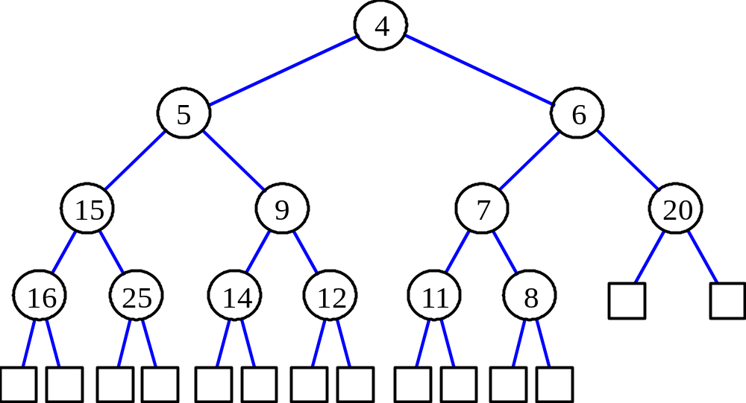
Heaps

Slide 4
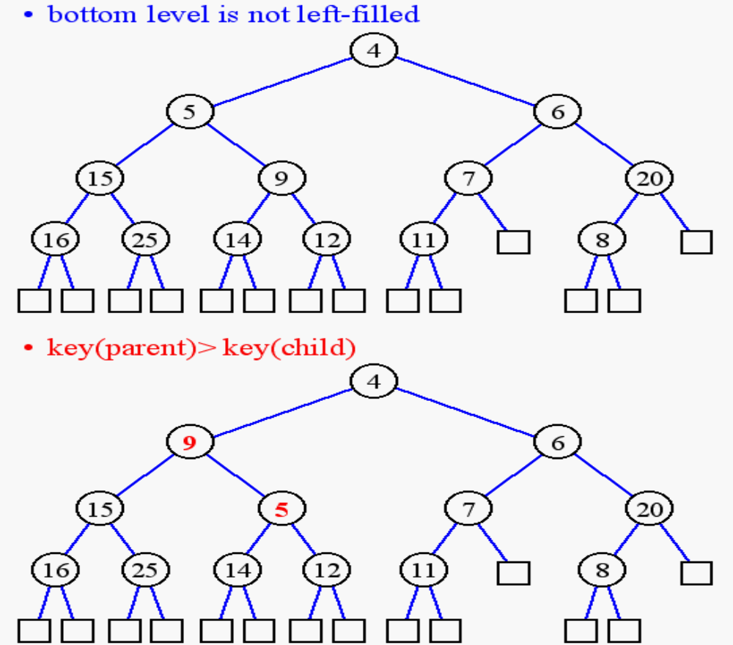
Not a Min Heap

Slide 5
Heap Properties
As heap is complete => height h = ⎣log(n + 1)⎦
So insert/remove is log)
Search is O(n) => not good to use it for that

Slide 6
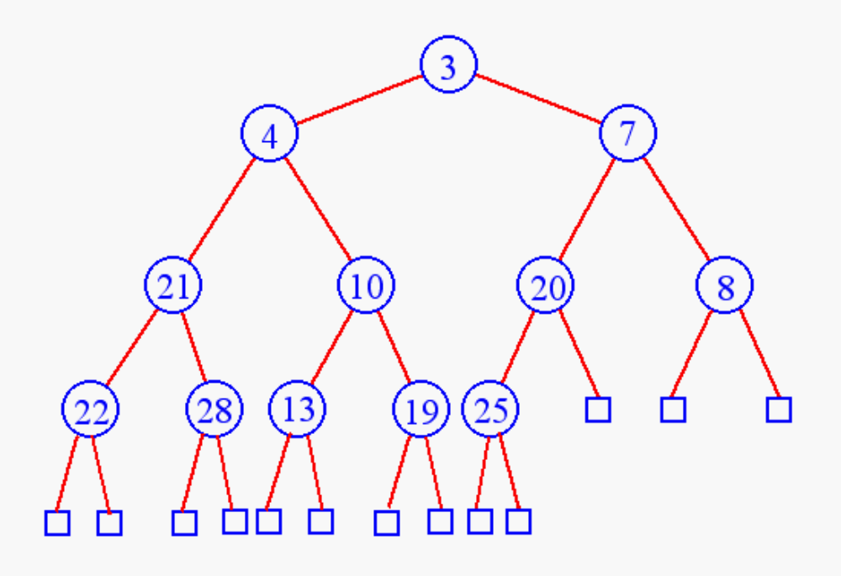
Min Heap Insertion
Insert 6

Slide 7
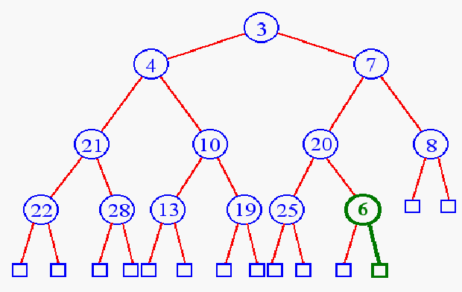
Heap Insertion
Add key in next available position

Slide 8
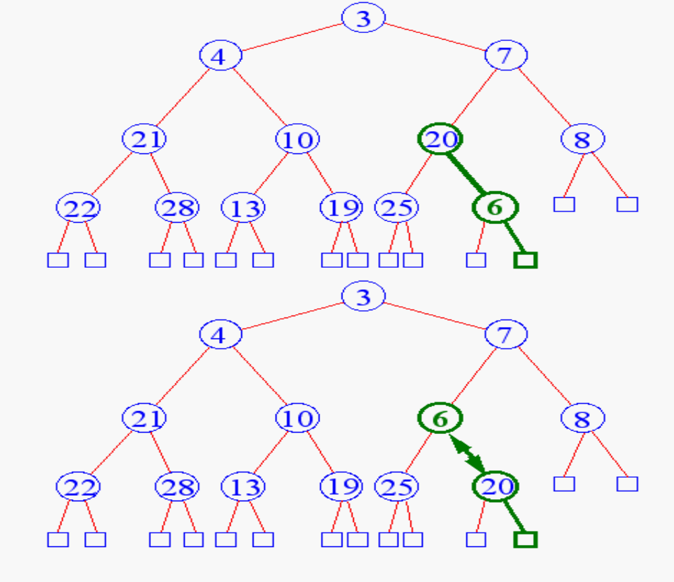
Heap Insertion
Begin reheap up

Slide 9
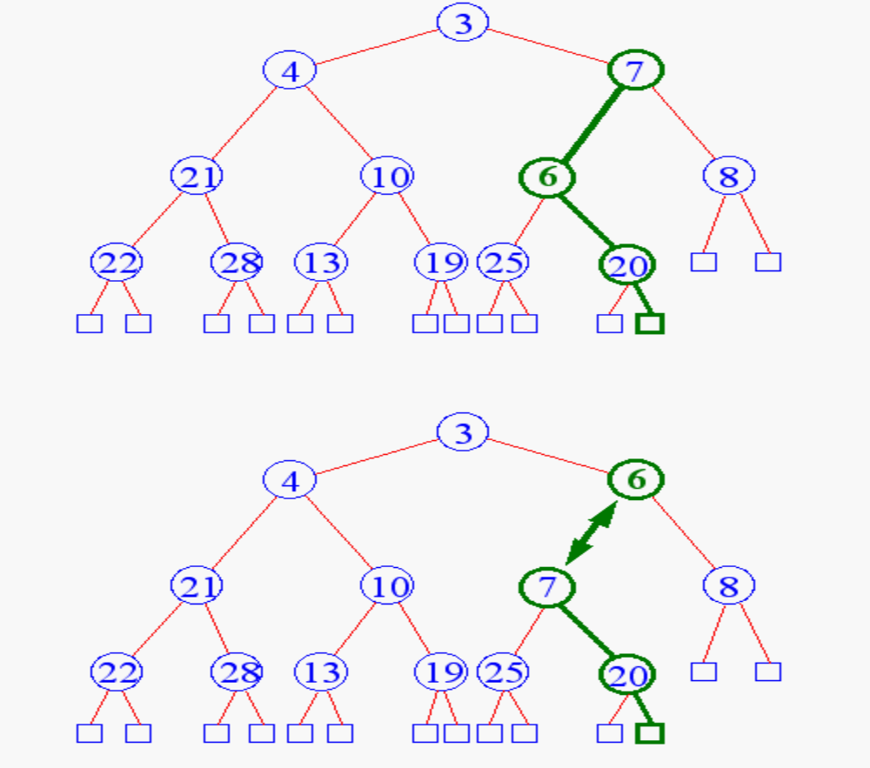
Heap Insertion

Slide 10
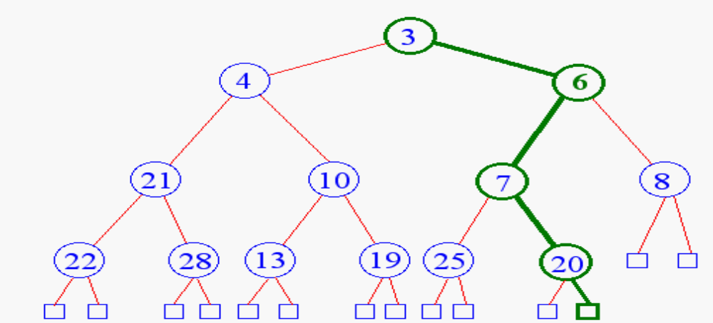

Heap Insertion
Terminate reheap up when
  reach root
  key child is greater than key parent

Slide 11
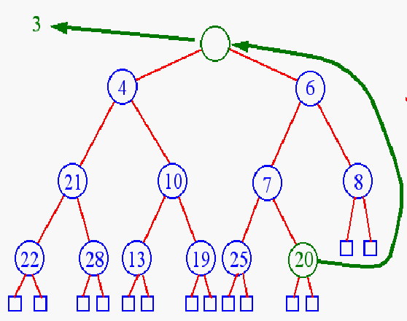
Min Heap Removal
Remove min element from the heap
Min Element on the root.

Slide 12
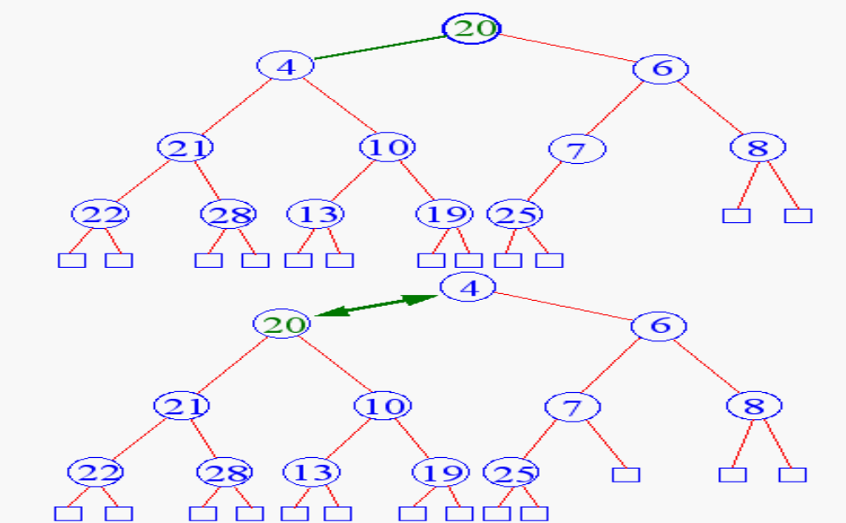
Heap Removal
Begin reheap down
  Select the child with the minimum value

Slide 13
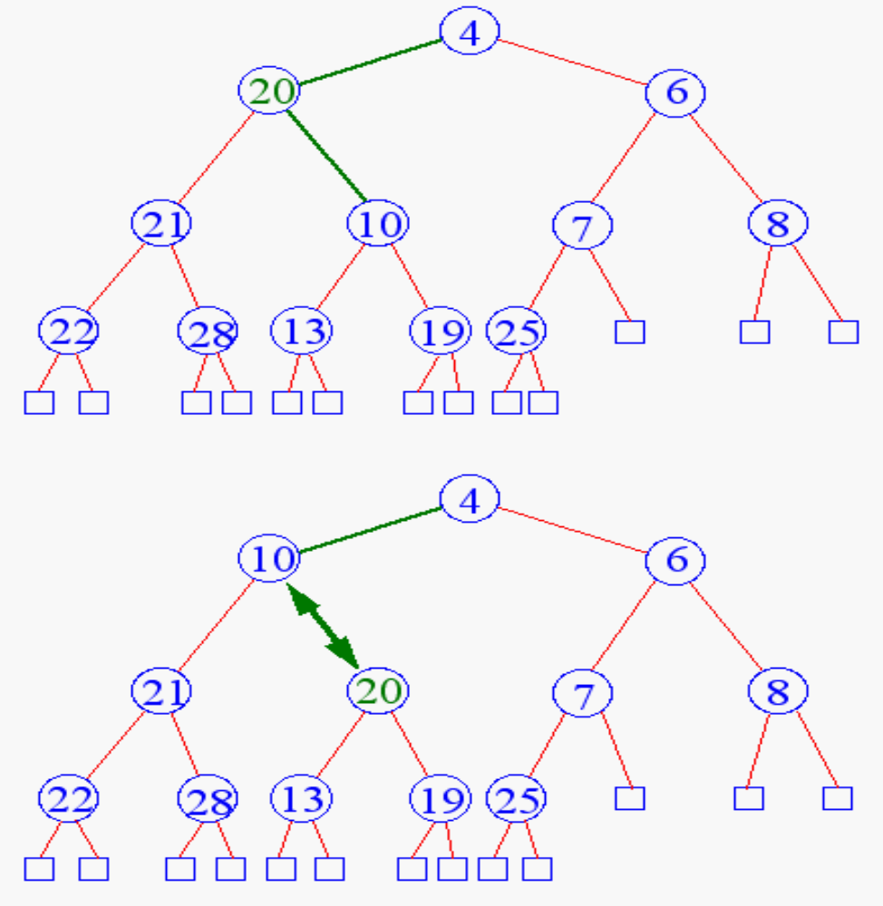
Heap Removal

Slide 14
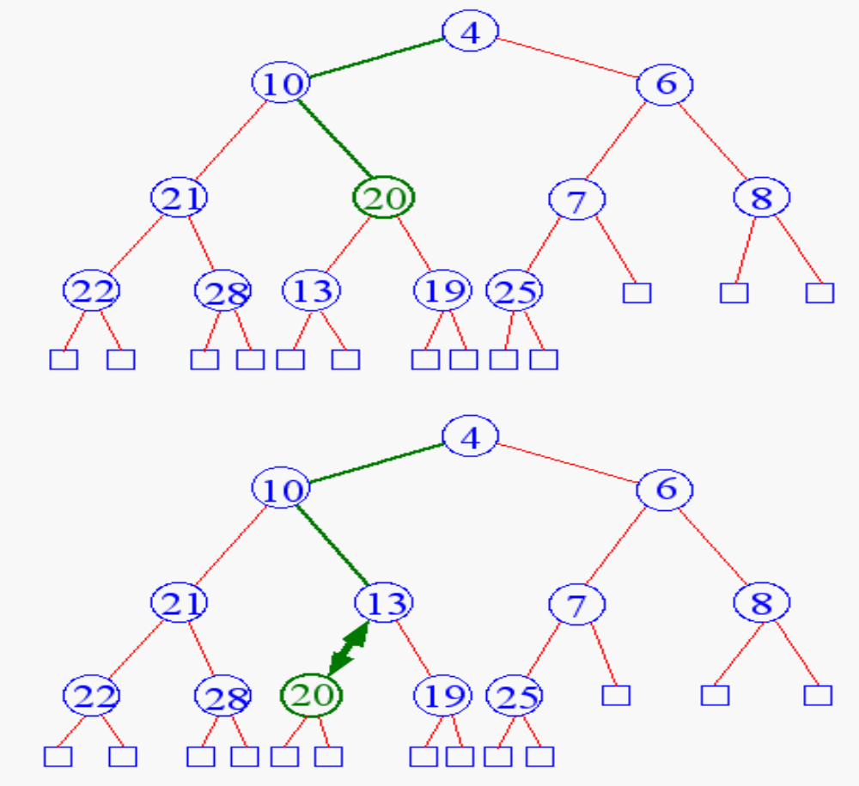
Heap Removal

Slide 15
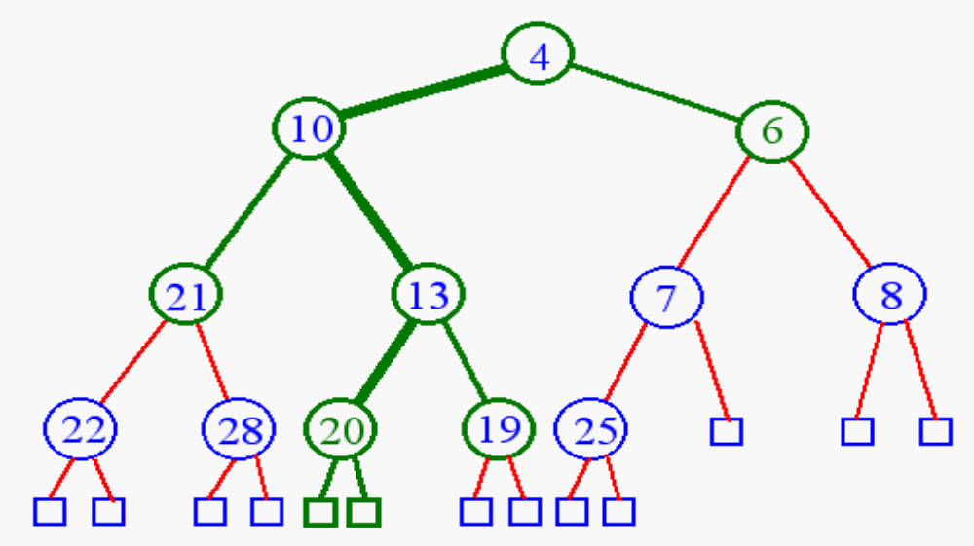
Heap Removal
Terminate reheap down when
  reach leaf level
  key parent is greater than key child

Slide 16
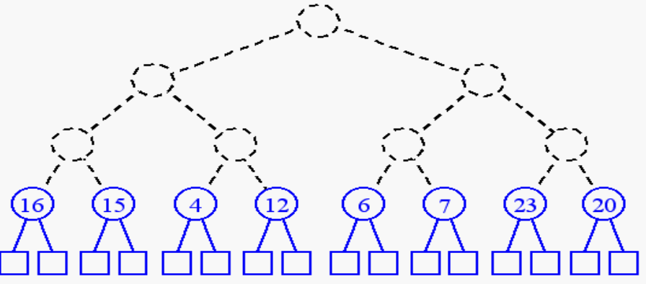
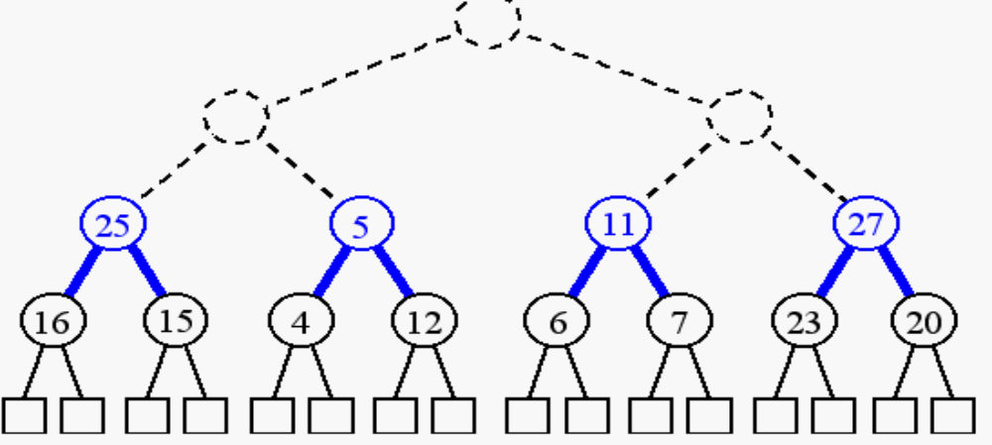
Building a Heap
build (n + 1)/2 trivial one-element heaps
build three-element heaps on top of them

Slide 17
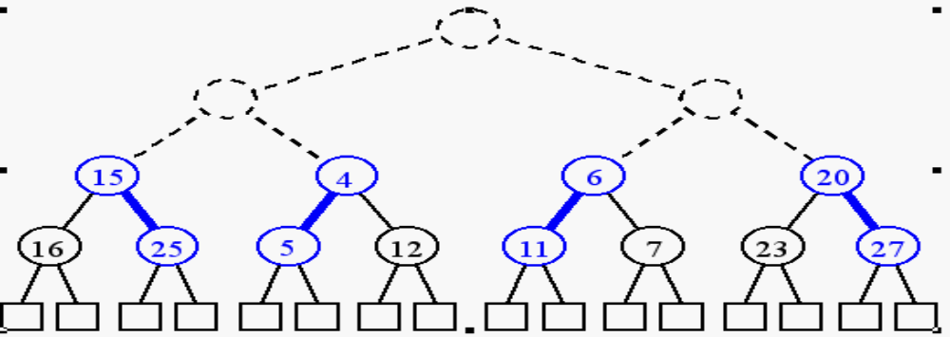
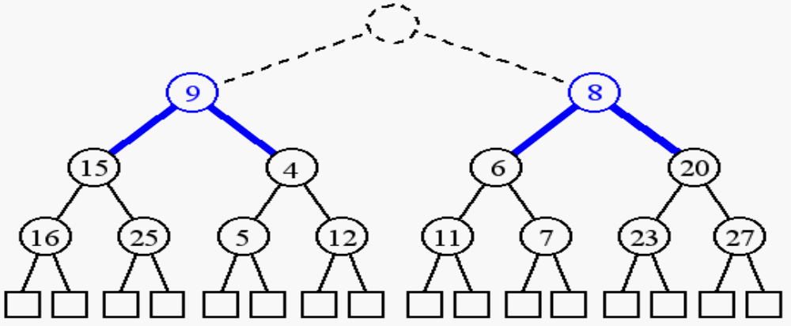
Building a Heap
downheap to preserve the order property
now form seven-element heaps

Slide 18
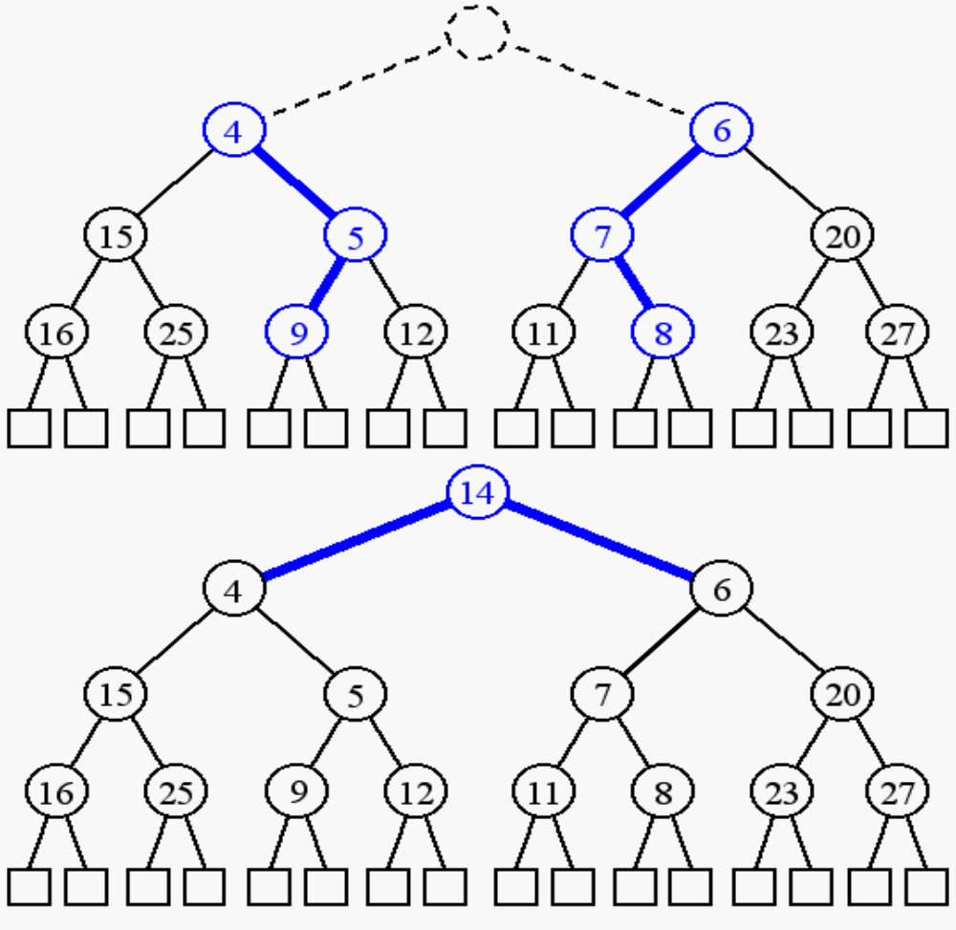
Building a Heap

Slide 19
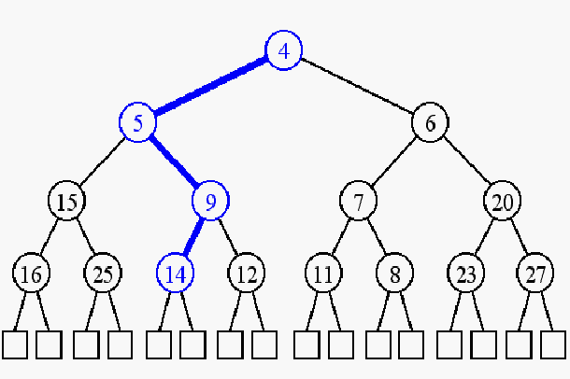
Building a Heap

Slide 20
INITIALIZE
template<class T>
void maxHeap<T>::initialize(T *theHeap, int theSize)
{// Initialize max heap to element array theHeap[1:theSize].
delete [] heap;
heap = theHeap;
heapSize = theSize;
// heapify
for (int root = heapSize / 2; root >= 1; root--)
{
T rootElement = heap[root];
// find place to put rootElement
int child = 2 * root; // parent of child is target
// location for rootElement
while (child <= heapSize)
{
// heap[child] should be larger sibling
if (child < heapSize && heap[child] < heap[child + 1])
child++;
// can we put rootElement in heap[child/2]?
if (rootElement >= heap[child])
break; // yes
// no
heap[child / 2] = heap[child]; // move child up
child *= 2; // move down a level
}
heap[child / 2] = rootElement;
}
}

Slide 21
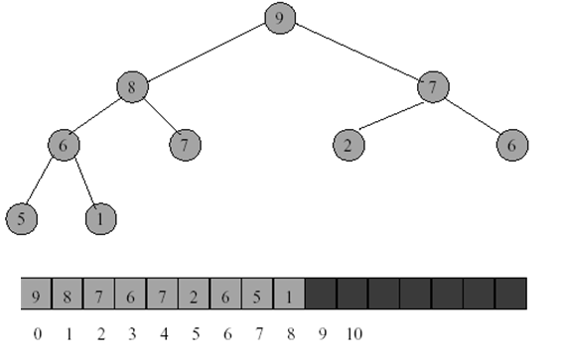
Array Representation of Heap
A heap is efficiently represented as an array.
Notes:
This slide from: http://dpnm.postech.ac.kr/cs233/lecture/lecture9.ppt
With small change of mine

Slide 22
What are Heaps Useful for?
Heap Sort: Insert all elements in the heap, then extract one by one
  O(nlogn)
  Other way with same order, is to initialize in O(n) not n insertions in O(nlogn)
To implement priority queues, which has many applications
Priority queue = a queue where all elements have a “priority” associated with them
Remove in a priority queue removes the element with the smallest priority

